Slide 1

QF623 Portfolio Management
Group Members: Brandon Lee Zi Cong, Chan Pak Lam, Nicole Lim Ying Xi, Peter Karuprasanth Chettiar

Slide 2



Presentation Outline
1. Background
2. Alpha
3. Portfolio
Overview of crypto landscape
Review existing literature to generate strategies
MVO and Stress-testing

Slide 3
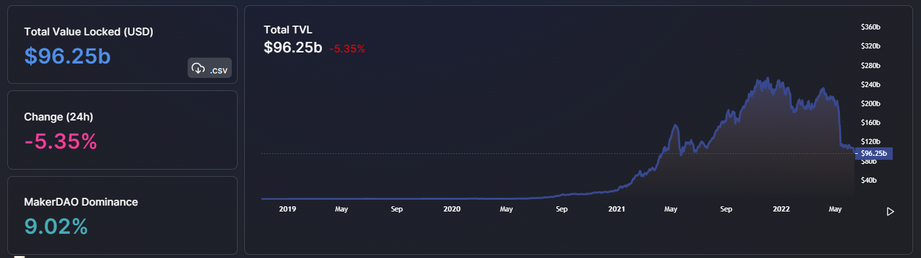
1. Background – $ locked in the ecosystem

Slide 4
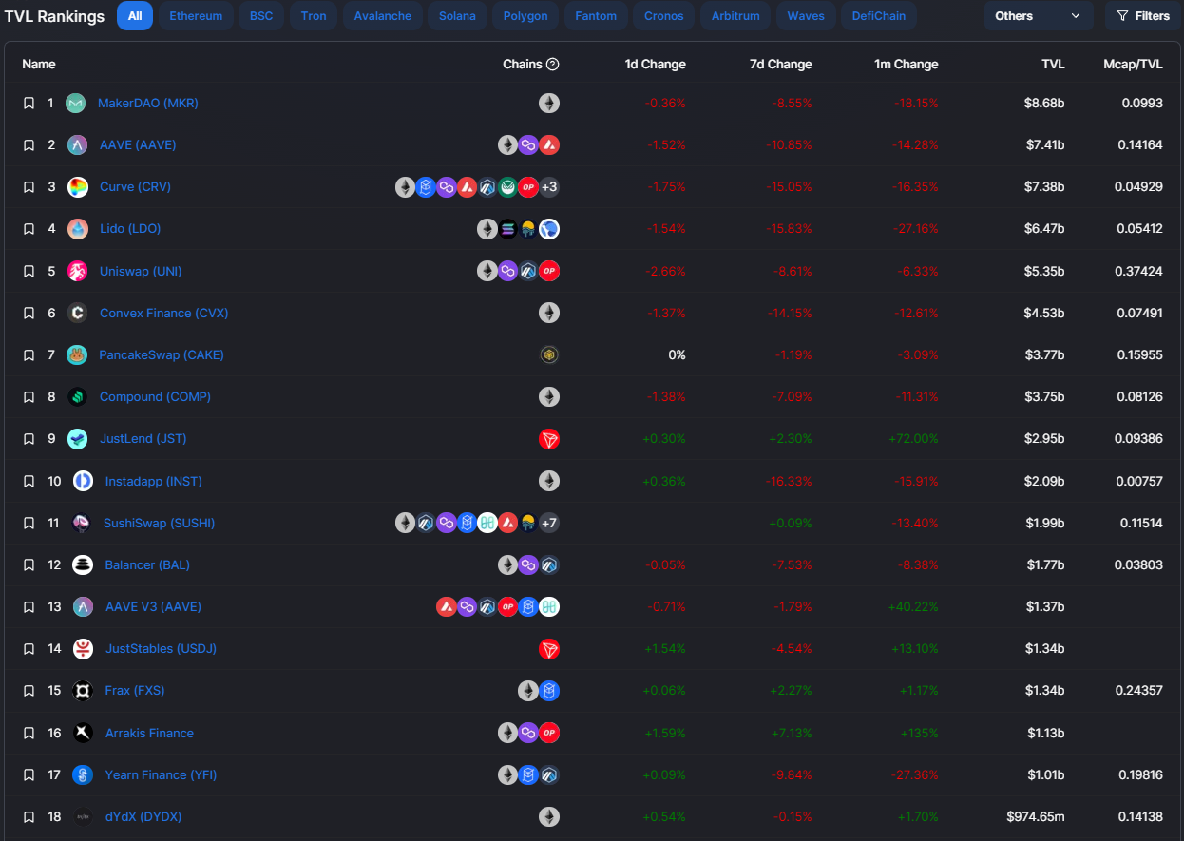
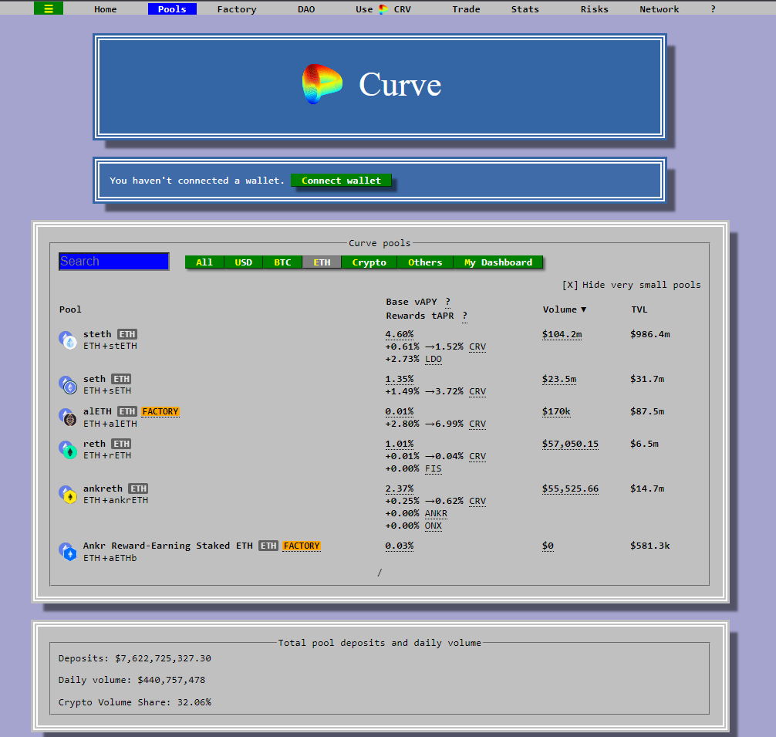
1. Background – Decentralized Exchanges (DEX)

Slide 5
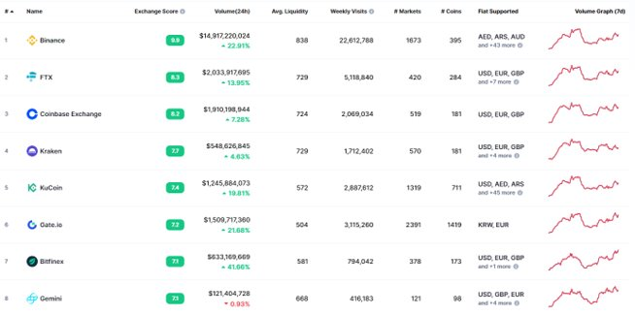
1. Background – Centralized Exchanges (CEX)

Slide 6
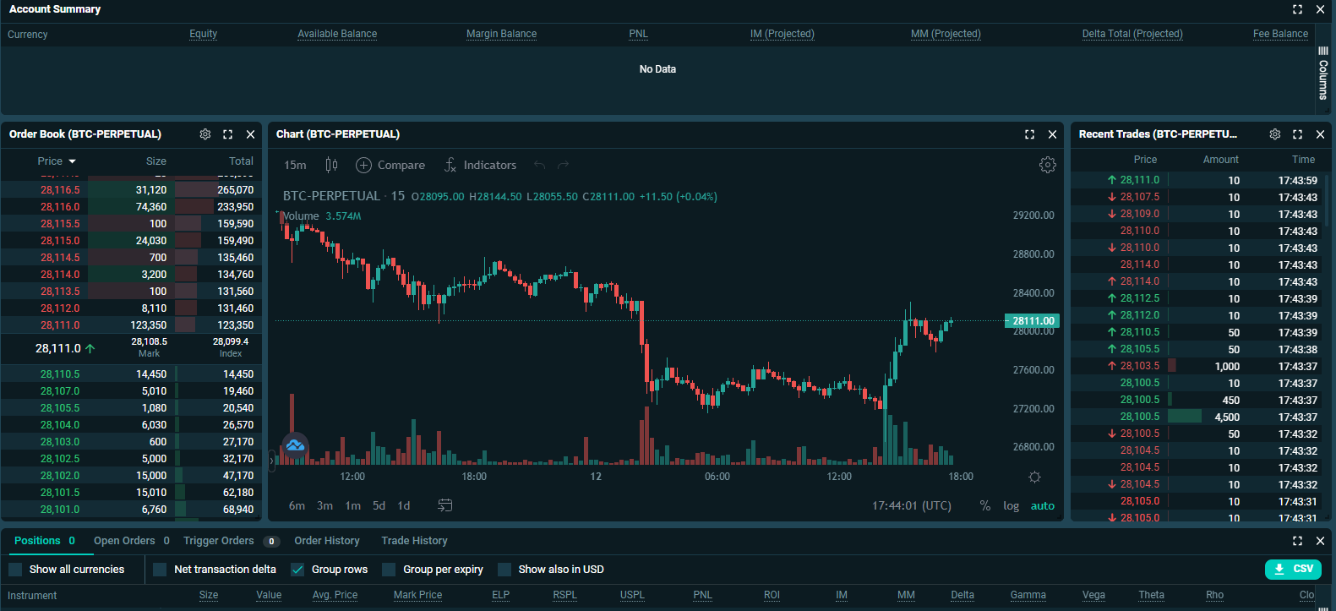
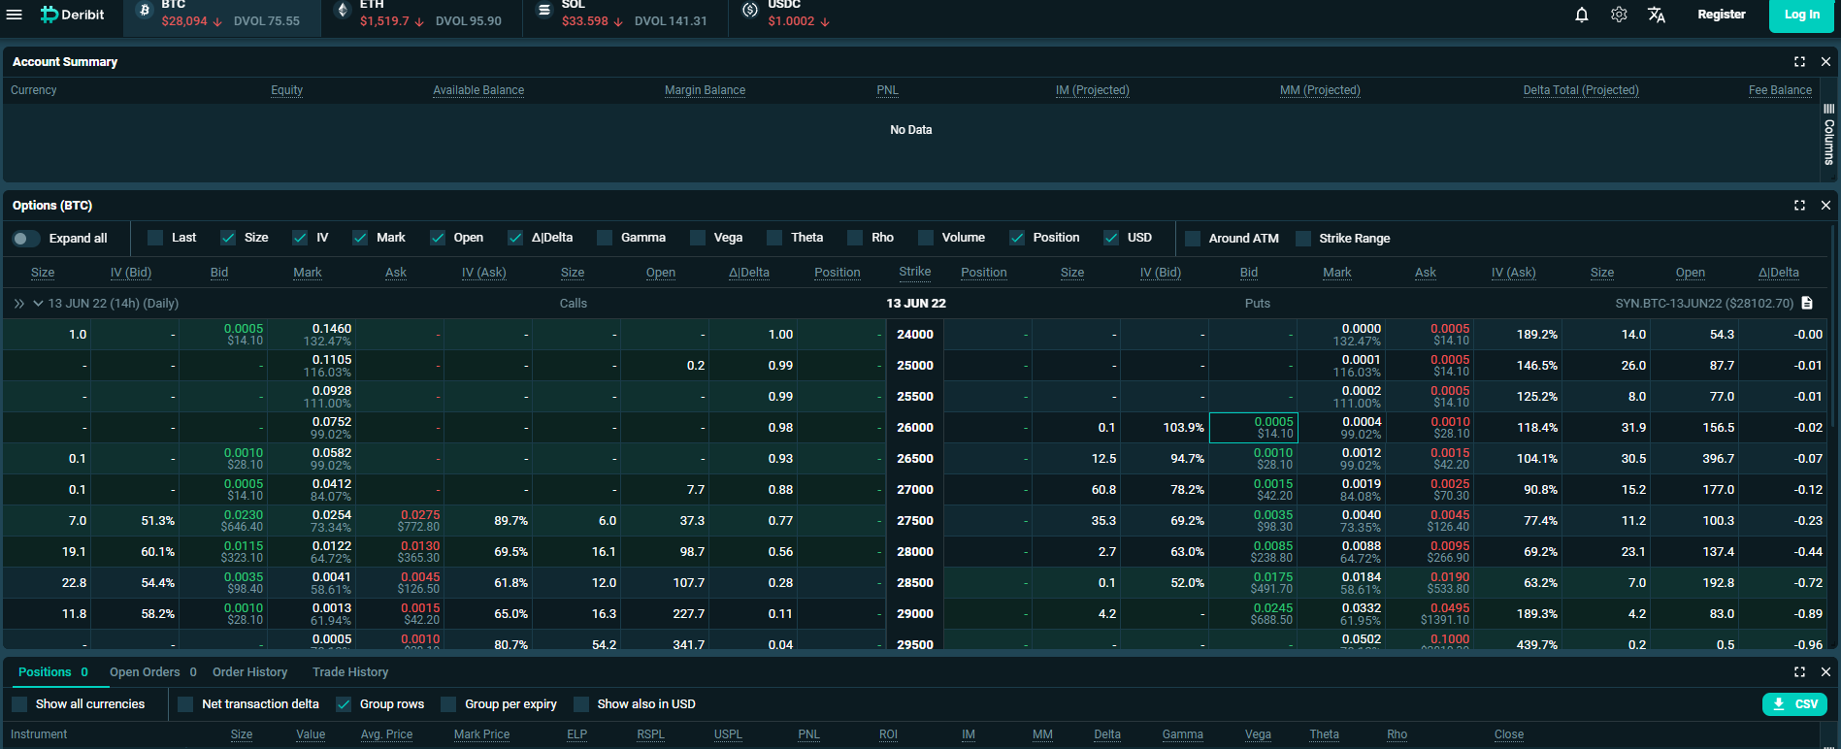
1. Background – Derivatives
Options
Futures

Slide 7
2. Finding Alphas
Cash-and-Carry
Google Trends
Short perp long spot
Prediction model based on search queries

Slide 8
2. Finding Alphas – Cash-and-Carry
Aka basis trading
Simple concept: Short futures + Long Spot
Market neutral, medium frequency, almost risk-free return
Futures tend to trade at a premium vs spot. Trade capitalizes on premium converging to zero.
Instruments of interest: 3m futures, BTC and ETH spot.

Slide 9
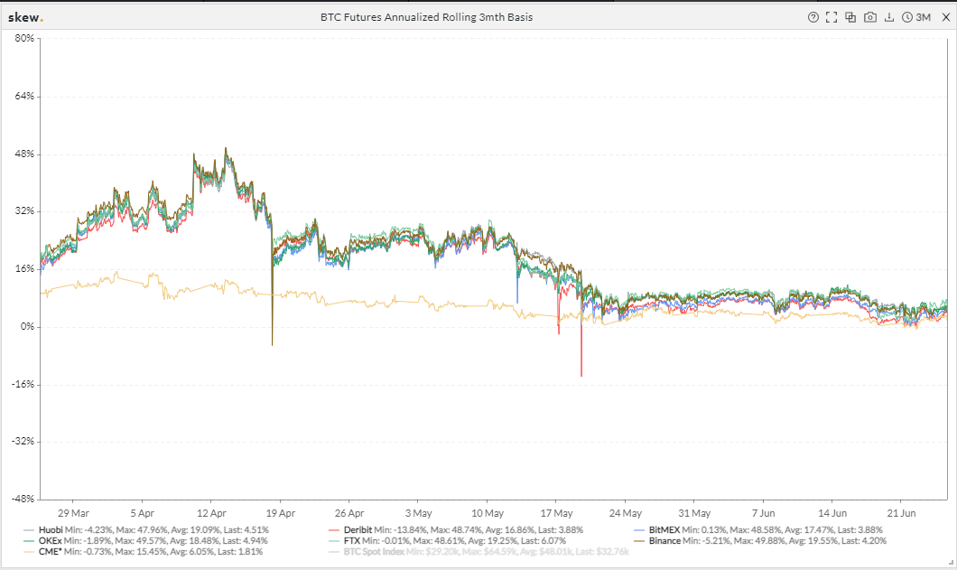
2. Finding Alphas – Cash-and-Carry

Slide 10
2. Finding Alphas – Cash-and-Carry
Annualized Return: 11.05%
Annualized Vol: 7.66%
Sharpe: 1.44
Annualized Return: 11.1%
Annualized Vol: 0.37%
Sharpe: 1.32

Slide 11
2. Finding Alphas – Google Trends
OLS regression model to predict returns
Predictor: 24 crypto-related search terms
Training coins: BTC, BNB, LINK, LTC, XMR, XRP
Test coins: ETH, BCH, DOGE, ADA
Buy signal: Predicted return below 25th percentile
Sell signal: Predicted return above 75th percentile

Slide 12
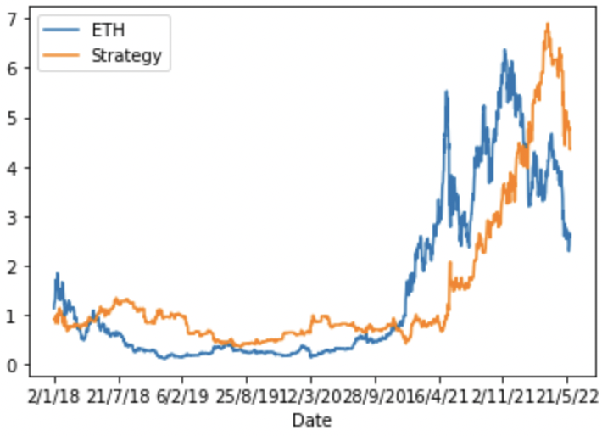
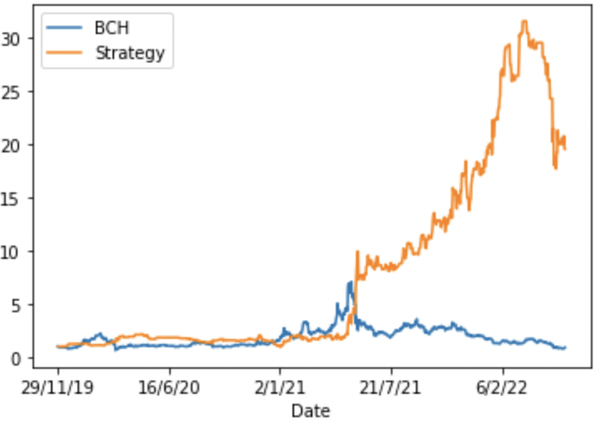
2. Finding Alphas – Google Trends
ETH Return: 127%
Strategy Return: 335%
Sharpe: 0.812
BCH Return: -8.67%
Strategy Return: 1,857%
Sharpe: 1.69

Slide 13
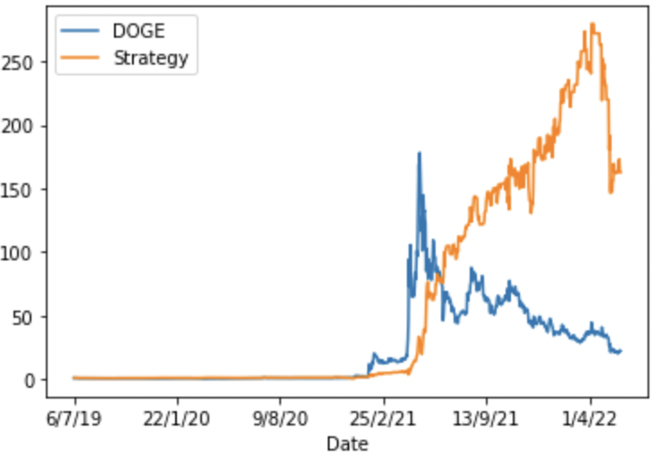
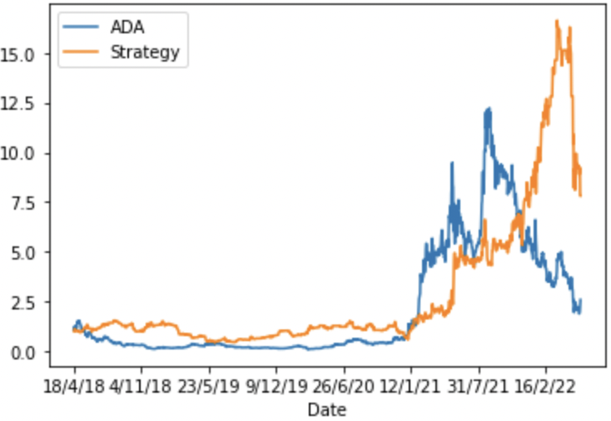
2. Finding Alphas – Google Trends
DOGE Return: 2,355%
Strategy Return: 16,167%
Sharpe: 1.89
ADA Return: 139%
Strategy Return: 681%
Sharpe: 1.00

Slide 14
3. Portfolio Optimization
01
Mean-Variance Optimization
02
Hierarchical-Risk Parity
03
The Critical Line Algorithm

Slide 15
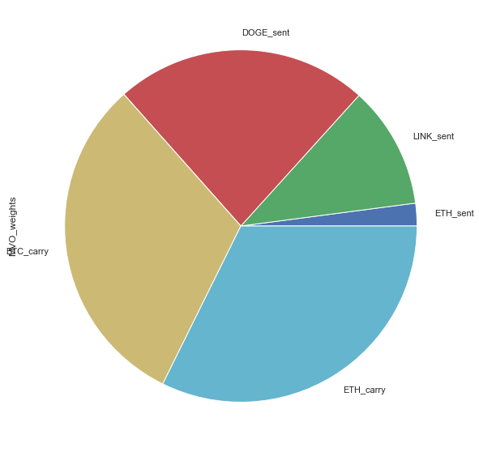
Mean-Variance Optimization
"Ledoit-Wolf" shrinkage - reduces extreme values in covariance matrix
Exponentially-weighted mean of (daily) historical returns, giving higher weight to more recent data.
Strategy Assets​ | Asset Allocation​
ETH_sent ​ | 0.02077​
LINK_sent ​ | 0.11222​
DOGE_sent​ | 0.23258​
ADA_sent​ | 0.00000​
BTC_carry ​ | 0.31142​
ETH_carry​ | 0.32301​

Slide 16
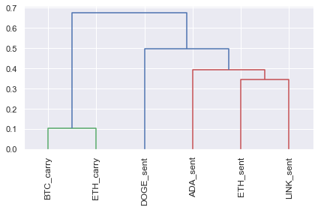
Hierarchical-Risk Parity (HRP)
How does HRP work?
From a universe of assets, form a distance matrix based on the correlation of the assets.
Using this distance matrix, cluster the assets into a tree via hierarchical clustering
Within each branch of the tree, form the minimum variance portfolio (normally between just two assets).
Iterate over each level, optimally combining the mini-portfolios at each node.

Slide 17
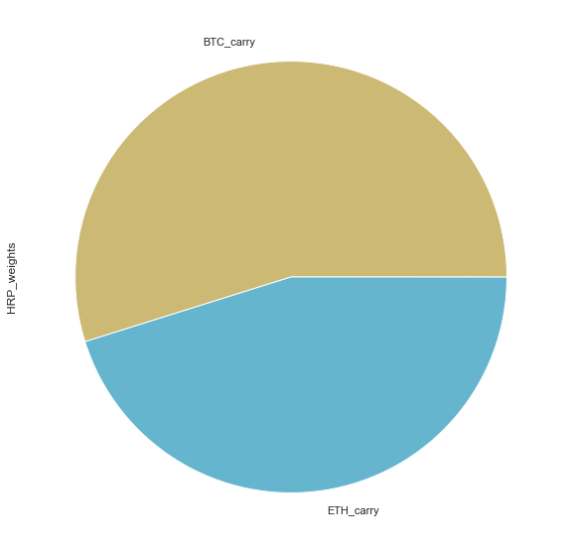
Hierarchical-Risk Parity
"Ledoit-Wolf" shrinkage - reduces the extreme values in the covariance matrix
Daily returns
Strategy Assets​ | Asset Allocation​
ETH_sent ​ | 0.00000​
LINK_sent ​ | 0.00000​
DOGE_sent​ | 0.00000​
ADA_sent​ | 0.00000​
BTC_carry ​ | 0.54843​
ETH_carry​ | 0.45153​

Slide 18
Critical Line Algorithm
Robust alternative to the quadratic solver used to find mean-variance optimal portfolios, especially advantageous when linear inequalities are applied.
Specially designed for portfolio optimization unlike generic convex optimization routines.
Guaranteed to converge after certain number of iterations and can efficiently derive the entire efficient frontier.

Slide 19
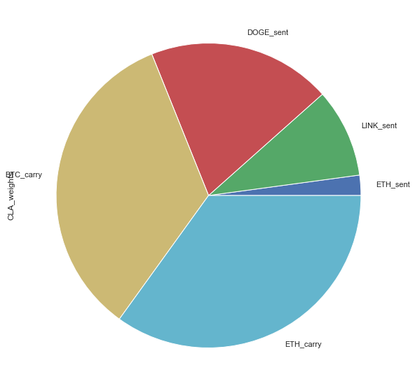
Critical Line Algorithm
"Ledoit-Wolf" shrinkage - reduces the extreme values in the covariance matrix
exponentially-weighted mean of (daily) historical returns, giving higher weight to more recent data.
Strategy Assets​ | Asset Allocation​
ETH_sent ​ | 0.02146​
LINK_sent ​ | 0.09430​
DOGE_sent​ | 0.19500​
ADA_sent​ | 0.00000​
BTC_carry ​ | 0.33978​
ETH_carry​ | 0.34946​

Slide 20
Fama French 3 Factor
 | MVO | HRP | CLA | S&P Crypto Broad
Market | 0.256 | 0.002 | 0.237 | 1.332
SMB | 0.124 | -0.001 | 0.121 | 0.370
HML | 0.180 | 0.001 | 0.159 | -0.154

Slide 21
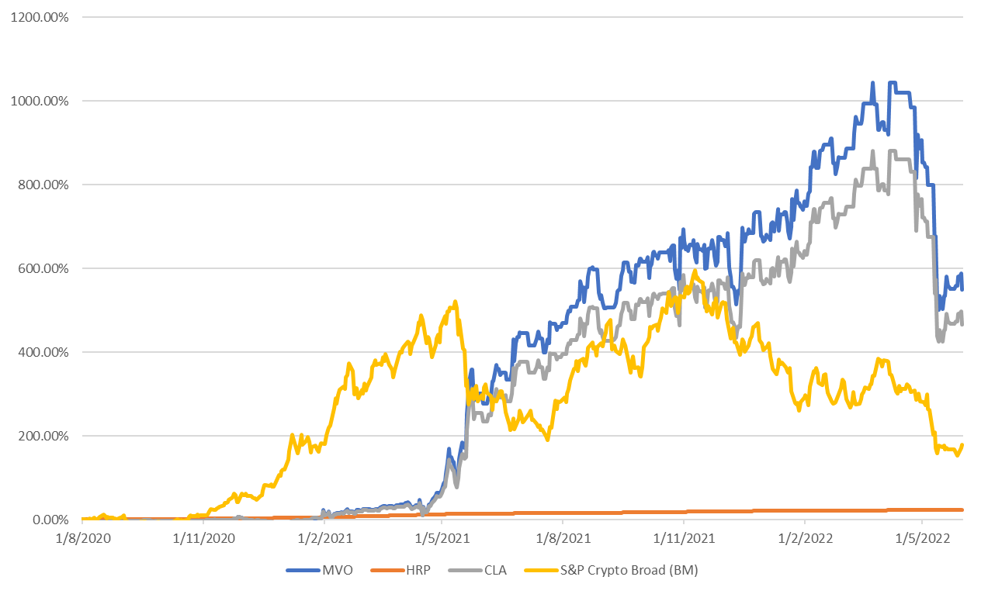
Simulated Returns

Slide 22
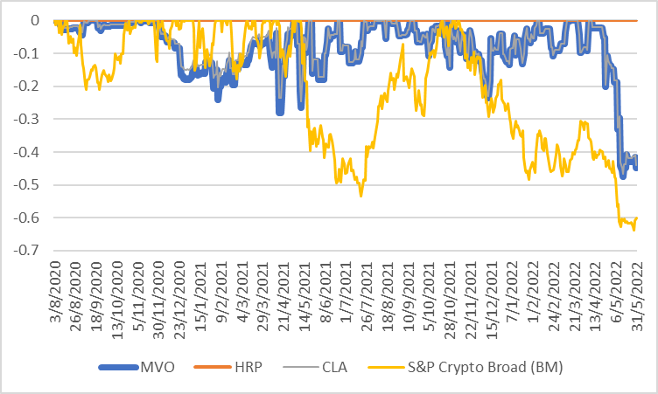
Drawdown

Slide 23
Portfolio Performance
 | MVO | HRP | CLA | S&P Crypto Broad
Annualised Return | 102.4% | 8% | 92.09% | 48.91%
Maximum Drawdown | 47.48% | 0% | 46.5% | 63.75%
Sharpe Ratio | 1.43 | 18.26 | 1.4 | 1.12
Sortino Ratio | 0.1459 | 106.24 | 0.14 | 0.1015

Slide 24
Conclusion
MVO and CLA have superior performance against benchmark
Sharp decline of 40% in May 2022
Imply long-only sentiment trading may not be appropriate during bear market
HRP which consist only cash and carry trades has limited downside but limited upside

